Slide 1
Phase 2 Project
Group 13:
Sharon Kaliku
Ezra Kipchirchir
Paul Kamau
Heri Kimotho
Kipkosgei Kiptui

Slide 2
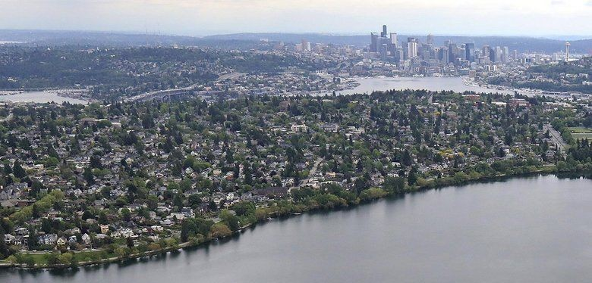
King County, Washington

Slide 3
The Business Case
A real estate company’s need to help its clients understand how prices of houses vary
The clients: 1. Homeowners
2. Potential house buyers

Slide 4
Objectives
Analyze relationship between location and price of houses
Analyze seasonal trends of price
Predict prices of houses depending on features

Slide 5
Data Understanding
Sources of data for analysis:
KC house data - Various features against price
Delivery locations - Zip-codes and their corresponding cities

Slide 6
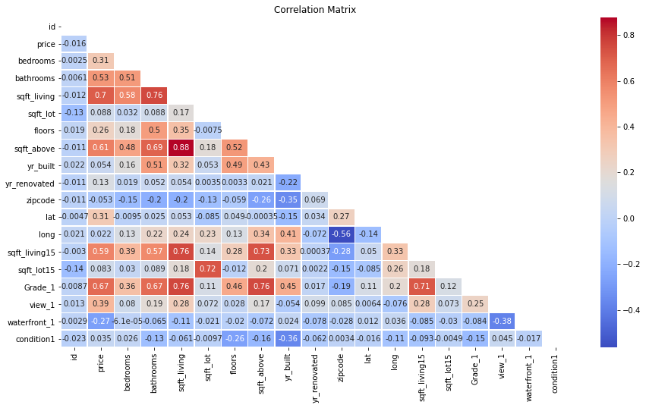
Data Visualization

Slide 7
Data Analysis
Visualized top cities with the most houses.
Showed the top ten cities with the highest prices.
Analyzed seasonal trends in prices
Created seasonal variables
Visualized trends and differences
Performed ANOVA test for seasonality

Slide 8
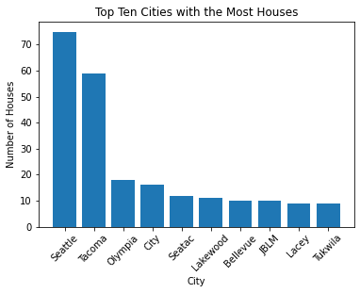
PRICE VS LOCATION
Seattle has the most houses
Tacoma is a close second

Slide 9
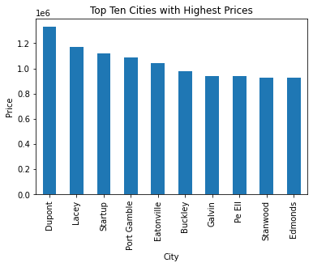
PRICE VS LOCATION
Dupont has houses with the highest prices
Lacey is a close second

Slide 10
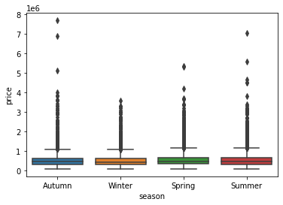
Seasonal Trends vs. Prices
Spring has the highest mean price
Winter has the lowest mean price

Slide 11
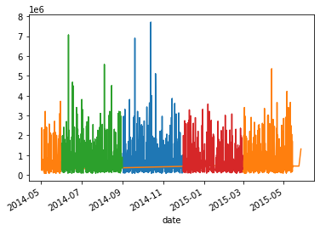
Seasonal trends vs. Prices
Spring and Autumn have the highest sales prices.

Slide 12
Linear Regression -Baseline Model
Detailing the selection of the target and features for the baseline model.
Explaining the process of splitting the data into training and test sets.
Providing the model summary and interpreting the findings:
F-statistic and R-squared.
Interpretation of coefficients.
Displaying the evaluation metrics:
Mean Absolute Error (MAE).
Mean Squared Error (MSE).
R-squared values for training and test sets.

Slide 13
Model Evaluation
Metrics for model evaluation
Compared R-squared values for training and test models
Visualized residuals for normality

Slide 14
Log Transformations
Discussed the need for target transformation
Performed a log transformation on the target
Visualized the transformed target
Created a new model with the log-transformed target
Model summary and evaluation

Slide 15
2nd Model (Multiple Linear Regression
Feature selection
Standardization of data
Model creation and summary
Model evaluation and metrics

Slide 16
Polynomial Transformation
Introduction to polynomial transformation
Transformation of features
Model creation and summary for polynomial regression
Analysis of coefficients and p-values

Slide 17
CONCLUSION RECOMMENDATIONS
1. The agency should be on the lookout for features such as square footage of the living area, square footage above,when advising and valuing house for homeowners because they have strong correlations to price.
2. The agency should be on the lookout for houses in the areas: Seattle, Tacoma, Olympia, City, Seatac, Lakewood, Bellevue, JBLM, Lacey, Tukwila because they have the highest number of houses
3. When advising homeowners, the agency should be aware that the areas: Dupont, Lacey, Startup, Port Gamble and Eatonville.

Slide 18
CONCLUSION RECOMMENDATIONS
4. The agency should be aware that the Spring season generally demands higher prices for the houses.
5. The agency should be aware that the Summer season generally demands lower prices for the houses.

Slide 19
NEXT STEPS
1. The agency should look for more data in regards to other house features.
2. The agency should conduct surveys to look find specific factors that cause this seasonal variation so as to understand the market better.
3. The agency should conduct research to find location specific data, such as social amenities, neighborhoods and political stability to understand why certain areas command higher prices as compared to other

